Slide 1
ALGAL FUEL
Green-a-thon
Rajasthan it day 2018
Project Presentation
For Environmental Friendly Energy Production
Presented by:
Dhruv Mangal
Ramnarayan Shrivastava

Slide 2
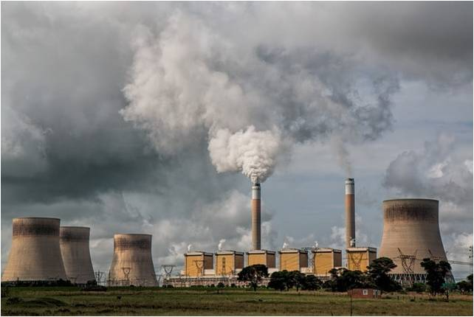
1.The Problem
The environment is getting more and more polluted everyday.
Pollution causing Global warming is leading to problems for livelihood(like greenhouse effect, acid rain, ozone depletion).
Energy demand is increasing day by day.
Need for green energy sources or renewable energy sources is rising.

Slide 3
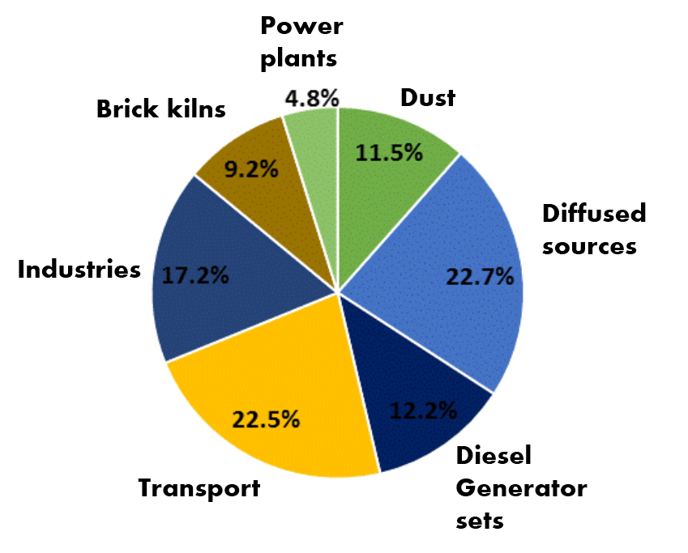
Pollution caused by sources in %

Slide 4
Effect : Worldwide
Polluting gases increasing overall temperature of planet causing global warming.
Pollen has increased
Radioactive waste causing cancer destroying ecosystem entirely.
Sea level is increasing.
Economy is affected by pollution by reduced productivity.

Slide 5
Our Work:
We have been working from last 3 months on this project because we were amazed by the potential of the Algal fuel and its possible applications.
We conducted a market research on benefits and efficiency of algal fuel.

Slide 6
The Idea
This idea is about designing of cultivation system to produce efficient algal fuel
The idea is not new as it was attempted before. It is derived from the conversion of sunlight into energy by algae in the form of oil.
The global market need this type of energy resources that can replace fossil fuel to help getting better the economy , environment, livelihood

Slide 7
2. Current Solutions
Electric and hybrid vehicles and public transport system
Ecologically friendly power technologies
Power from the sun
EM reduction

Slide 8
2.1 Solutions in Rajasthan
Introducing metro to Reduction in fuel consumption through reduction in number of buses and private vehicles
Amanishah nala is being converted into dravyawati nadi.
Tree plantation on every major road.
Proper management of waste under ‘Swachh Bharat Abhiyan’.
Using solar panels and wind turbines for energy generation

Slide 9
3.1 Solution We Propose: Algal Fuel
Our aim from this proposal is to design a cultivation system to produce algal fuel.
It must be productive ,also cost and energy efficient at the same time.
Also to determine the efficiency of the system by comparison to current conventional fuels.

Slide 10
Concept:-
Algae are simple plants that ranges from microalgae to macroalgae.
They are rich sources of oil. The oil part found in algae is much larger than corn and other oil sources.
Algae can grow into nitrogen depleted condition so that the oil part in algae increases.
By using open pond system or photobioreactor algae can be converted into algal oil.
And further refined into algal fuel.

Slide 11
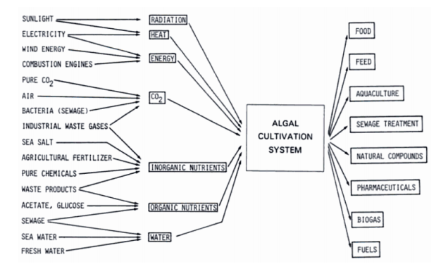

Slide 13
4.1 What is algae
Algae are simple plants that range from microalgae to macroalgae.
Algae form a vast group of eukaryotic, autotrophs which do photosynthesis in both marine and freshwater ecosystems
Can be grown using brackish-, waste-water and sea water.
the most primitive plant species on earth

Slide 14
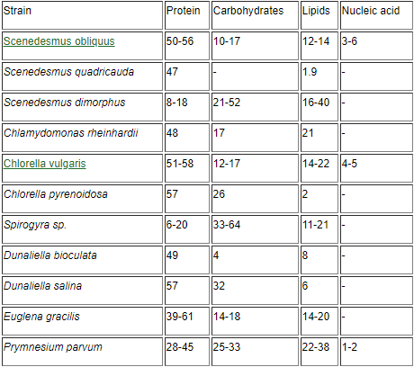

Slide 15
4.2 Why Algae?
primary fixer of CO2 in the atmosphere by carrying out 80% of the world’s photosynthesis
There is a solution to these challenges in the form of earths oldest organism: Algae.
Energy Security: India imports $330 ml a day on imported gas and oil
Economic Security: About 70% of India's electricity generation is from fossil fuels.

Slide 16
Why algae?(continued )
They make up most of the mass of photoplankton.
The algae being the primary producers oxygenate the water, allowing growth of aquatic aerobic bacteria.
More efficient converters of solar energy because of their simple cellular structure.
Climate Change: We must reduce our greenhouse gas emissions and protect and preserve our land, water, air and soil by developing renewable and sustainable energy sources.

Slide 17
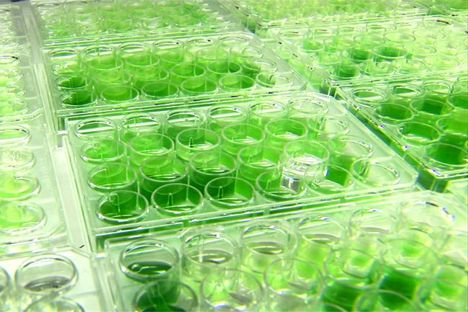

Slide 18
5.1Production of algae
Algae are cultivated on land in large ponds or in photobioreactors.
Algae reproduce very quickly ,they need only sunlight ad some nutrients which are artificially provided time to time to ensure optimal growth of algae in closed environment and are naturally available in open environment.

Slide 19
5.2 classification of algae
Classified into 6 groups.
The pigments of the chlorophyll are especially important since they dictate the habitat for the strain.
it will develop best in an environment rich in the wavelengths of light its pigments absorbs.

Slide 20
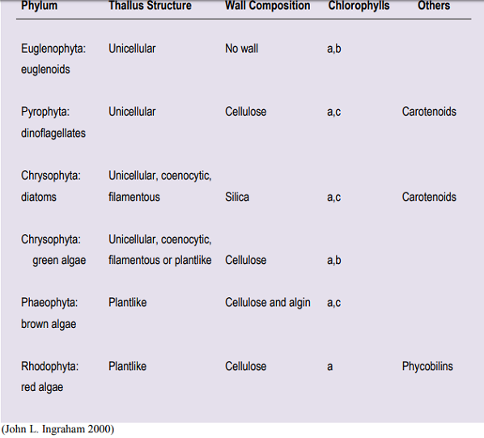

Slide 21
5.3 Growth kinetic of algae
Reproduction of bacteria is an autocatalytic reaction meaning that the speed of growth is directly related to cell concentration:
substrates + cells → extracellular products + more cells
∑S + X → ∑P + nX
s: substrate x: cell mass concentration
p: product conc., n: increased no of biomass

Slide 22
Growth kinetic of algae(cont.)
Integrating the specific growth rate equation gives the number of cells as a function of time:
X=X0 exp(mnet t)
Algae growth has same characteristics as microbial growth.
it follows the same typical phases of the batch microorganism growth: lag phase, exponential phase, stationary phase, and depletion phase :

Slide 23
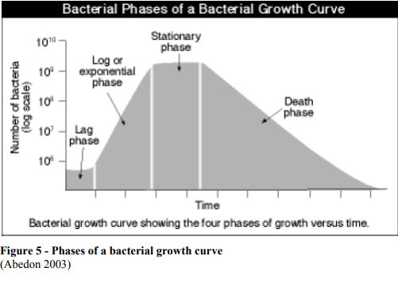

Slide 24
5.4 Condition influencing growth
Factors that affect generation time of algae: pH, Temperature, salinity and nutrients
Microalgae do not react to these changes linearly.
When outside the optimal range , growth rates decline sharply.

Slide 25
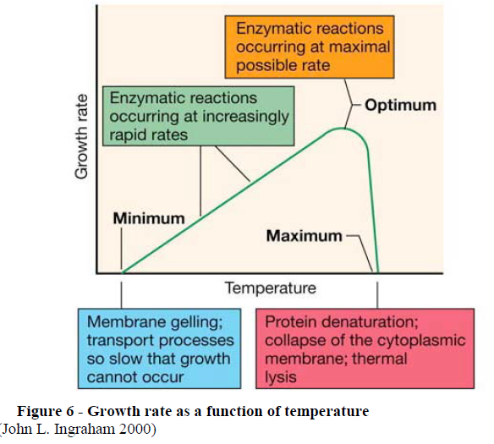

Slide 26
5.5 Biomass and lipid productivity
Algal biomass is always made up of these three main components:
Carbohydrates, Protein and Natural Oils
In these natural oils(10-40%) can be converted to algal fuel.
Biomass productivity is the rate at which algae produces
And lipid content is the percentage of lipid in total mass

Slide 27
5.6 Nutrition required
Inorganic nutrition : CO2,N2, P, S
Trace elements: metals and growth factors(vitamins)
C.N.P. ratio: 106:16:1
Deviates from this ratio cause eutrophication.

Slide 28
5.7 Effect of nitrogen deprivation
Nitrogen depleted medium develop a higher lipid content than nutrient sufficient condition.
In this, the cell can not create more cells and therefore channel toward lipid production
15-20% lipid decreases in night by undergoing to the process of respiration

Slide 29
5.7 Effect of nitrogen deprivation
Nitrogen depleted medium develop a higher lipid content than nutrient sufficient condition.
In this, the cell can not create more cells and therefore channel toward lipid production
15-20% lipid decreases in night by undergoing to the process of respiration

Slide 30
5.8 photoinhibition
Algae subjected to too much light energy
So algae become damaged.
Hence decreased productivity
Irradiance between 1800 and 2200 muEm-2s-1 are considered.

Slide 31
5.9Likely algae candidates
With these parameters, algal strain can be selected.

Slide 32
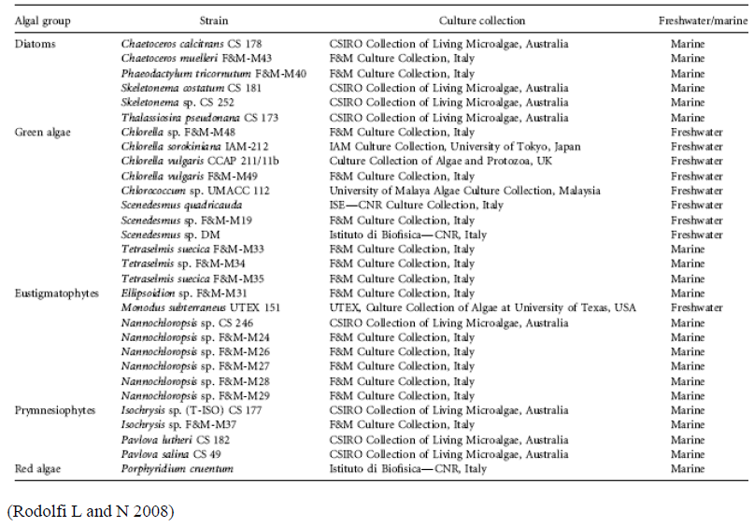

Slide 33
6.1 Description of algae cultivation
Can be viewed as i/o process.
Process divided into 2 phase
Phase 1: vigorous algal growth
Phase 2: growth in nitrogen depleted condition
And the overall contain increases.

Slide 34
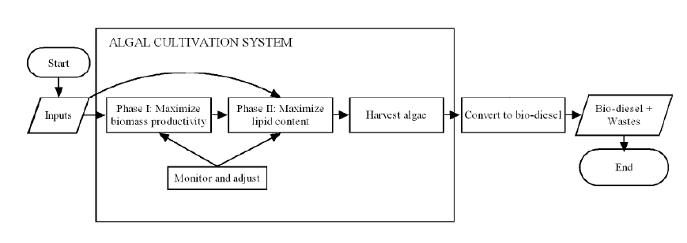

Slide 35
Open pond system
Most studied method for mass cultivation.
Consist or natural or artificial waters
This has very low cost and very simple to construct
Temperature and light cant be regulated
Low concentration of algae in the pond tend to make harvesting less efficient.

Slide 36
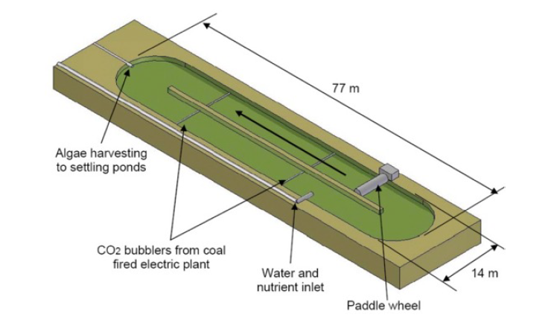

Slide 37
Photobioreactors
Due to limitation of open pond most of the research is conducted using Photobioreactor.
Provides free lighting and temperature for different algae.
Having system outdoor would be much cheaper and brings down the cost

Slide 38
Airlift photobioreactor
Airlift is device that serves to circulate through the solar receiver
A gas liquid separator found at the top of the air lift prevents oxygen from going back to system
Flow pattern and circulation times within are easy to follow and understand.

Slide 39
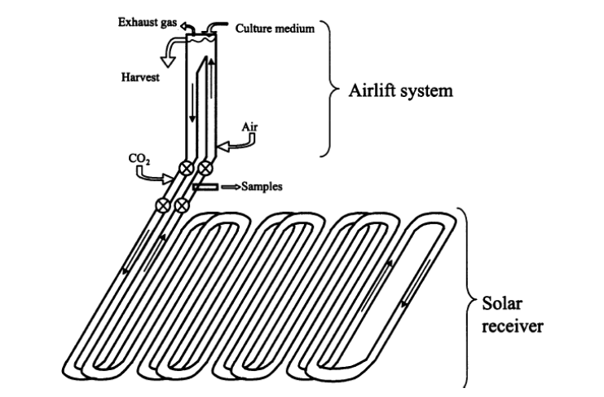

Slide 40
Tubular photobioreactors
It consists of an airlift system and a solar receiver.
A solar receiver is a large lines of tubes that intertwine over a large surface.
It has large surface area since it is spread on a long and large distance.

Slide 41
Feasibility of idea
There are 3 generation of biofuels
1st generation from food corps
2nd generation from lignocellulose biomass
Algal fuel is considered as 3rd generation biofuel.

Slide 42
The biology of algae
Algae has 3 types: seaweeds, microalgae, cynobacteria
Microalgae’s 2 classes diatoms and green algae have shown the promise for using as biofuel.
The productivity of algal fuel depend on the maintenance of appropriate temp. ,gas exchange, photosynthesis,avaibility of proper nutriants

Slide 43
The main benefits of algae
High productivity
Non food feedstock
Non productive land use
Relative difference to water source
Co products
Recycling of waste stream

Slide 44
Challenges
Isolation of algal strain for mass culture
Manage ponds for algal species and culture stability
Maximize overall biomass productivity
Maximize c storage products
Demonstrate large scale low cost algal cultivation
Develop low cost harvesting technologies

Slide 45
challenges
Processing for biofuels and higher value co products
Demonstrate waste treatment- nutrient recovery
Photosynthesis limitation
Light saturation

Slide 46
Revenue model
The global algae oil market size was valued USD1.38 billion in and expected to grow at CAGR of 4.3%

Slide 47
Sceneri-o |  | Operating days | Biomass productivity | Power consumption | Area | Water evaporation | Cost of water CO2
Raceway pounds | Base case - LA | 300 | 10^a | 1 | 400 | 10 | include
 | Base case- HA | 360
 | Projected case LA | 300 | 20^a |  |  |  | exclude
 | Project case -HA | 360

Slide 48
Scenerio |  | Operating days | Biomass productivity | Power consumption | Area (ha) | Water evaporation | Cost of water
PBR | Base case LA | 300 | 20^b | 500 | 10 | .5 | Included
 | Base case HA | 360
 | Projected case- LA | 300 | 40^b | 50 |  |  | Excluded
 | Projected case -HA | 360

Slide 49
a: Productivity assumption based on judgment and experience of the aqua FEUL partners
b: productivity assumption extrapolated from experimental data incorporating future technical advances.
The base case production cost is ∼Rs147 kg⁻¹ to Rs 165 kg⁻¹ and the projected case cost is ∼Rs 28 kg⁻¹ to Rs 37 kg⁻¹. It can also be seen that there is little difference between the low and high availability cases (fractional difference ∼5%).

Slide 50
Market competitiveness
Main competition of algal fuel is with fossil fuels
Both generates energy but biofuel generates low cost and low carbon emission
Algal fuel are carbon neutral so unlike fossil fuel they don’t contribute to global warming.

Slide 51
SWOT analysis
Strength:
Raceway ponds are there for commercial news
Capital cost decreases by increasing scales
Heat and co2 will be transported over the fence by neighboring industry

Slide 52
Swot analysis
Weakness
LCA shows very high heat losses
Cost of land is substantial
Digestate may be contaminated by unwanted micro organism like bacteria
Purification of land adds extra coast

Slide 53
Swot analysis
Opportunity
Liquid digest is available at zero cost
Onsite renewable heat production may be eligible for government financial support.
Investments towards projects upscaling PBR technologies for other market products e.g. food/feed, will benefit energetic algae cultivation projects via technology transfer.

Slide 54
Swot analysis
Threat
Alternative biofuel production technologies are more cost effective than energetic algae and as such more attractive for investors1.

Slide 55
Probable outcomes
The realization is not as easy as we expected.
After doing a lot of research one will be able to successful launch the cultivation
In starting cost will be high
Break even will be approx 2 years.

Slide 56
Future aspects
After a lot of research algae will be able to produce more efficient fuel
As uses gets high the dependency upon fossil fuel will get lower
Environment will start to get more cleaner
Approx market of algal fuel will reach upto 1.2 billion in 2023.

Slide 57
Thankyou

